Slide 1
Artificial Intelligence? Introduction
Notes:
I'm going to start by talking about what artificial intelligence is, and why we do it.
And then I'll give you a little bit of the history of artificial intelligence, and conclude with some of the topics we will cover during the course.

Slide 2
What is Artificial Intelligence?
Thinking
2
11
modelling
Perception
representation
constraints
algorithms
3
Acting
Notes:
So, what is Artificial Intelligence (AI).
Let us think what we deal with to have an idea of AI.
In general it must have to do with thinking. So let us define AI is about thinking, whatever his is.
But it is more. It is about perception and it is about action.
And as we talk about Artificial intelligence that we want to create, that we want to use, we are speaking about modelling.
Models of thinking, models of perception and models of action. How we build these models is the main topic of AI at least in Computer Science.
This approach was also one of the main concerns when AI started to get investigated – to understand better what thinking is and how it works, to model human thinking and test if the model is appropriate. Appropriate in general or for special tasks.
And the model needs a representation of the problem we want to model and some constraints that belong to our model. We must give things a name to deal with, we must find an agreement of the special meanings of something, we need a concept.
After all we want to build programs, so we need the algorithms to do that too. Algorithms, procedures, methods, all the things we need to get things work.

Slide 3
What is Artificial Intelligence?
"The art of creating machines that perform
functions that require intelligence when performed
by people" (Kurzweil, 1990)
"A field of study that seeks to explain and
emulate intelligent behavior in terms of
computational processes" (Schalkoff, 1990)
"[The automation of] activities that we associate with human thinking, activities such as decision-making, problem solving, learning ...“ (Bellman, 1978)
"The study of mental faculties through the
use of computational models"
(Charniak and McDermott, 1985)
"The study of how to make computers do things at which, at the moment, people are better" (Rich and Knight, 1991 )
The exciting new effort to make computers
think . . . machines with minds, in the full
and literal sense" (Haugeland, 1985)
"The study of the computations that make
it possible to perceive, reason, and act"
(Winston, 1992)
"The branch of computer science that is concerned
with the automation of intelligent
behavior" (Luger and Stubblefield, 1993)
Notes:
So, what else is Artificial Intelligence (AI).
We see some definitions of AI I took from the Norvigs textbook, the textbook our course is based on. We see there is no simple and general accepted definition of Artificial intelligence, hence we have a lot of different definitions.
I believe if there would be one exact definition we wouldn‘t find different snippets
The reason that we don‘t have an unique definition is that there are also different views of artificial intelligence and of intelligence at all.
Think about: Are animals intelligent?
Can there be intelligence without acting?
What describes human intelligence?
To study AI it is not necessary to know all the different views and definitions of AI, but you should understand what opinions exists and where they come from.

Slide 4
AI – one textbook definition
Artificial intelligence is a sub-field of computer science. Its goal is to enable the development of computers that are able to do things normally done by people -- in particular, things associated with people acting intelligently.
Stanford researcher John McCarthy coined the term in 1956 during what is now called The Dartmouth Conference, where the core mission of the AI field was defined.
Notes:
Although we spoke about the ingredients we have for AI, we will discuss deeper the views and meanings about AI.
Let us start with a common textbook definition, a definitionfrom John McCarthy, one of the first and mostly known AI pioneers.
“Artificial intelligence is a sub-field of computer science. Its goal is to enable the development of computers that are able to do things normally done by people -- in particular, things associated with people acting intelligently.”
This definition was take at a time computers had just been developed and people thought about the capacity of what computers can do very optimistic. It seemed only a question of time when computers are able to do things in a human way. And this definition implies that we don’t understand intelligence at all, so it is enough that computers do it like humans. It is a simple logic here:
- Humans exists
- Computers exists
- Human do things intelligent
IF Computers do things like an human THEN they do it intelligent
NO else
AI tries to act as we usually think which is done intelligently. But this doesn‘t tell us something about:
what is intelligence?.
Is there a way for artificial intelligence?
how can we decide if an application or a computer is intelligent?
when do we think people are acting intelligent?

Slide 5
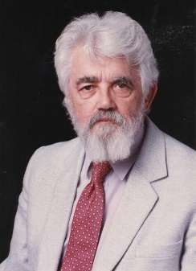
John McCarthy What is Artificial Intelligence?
What is artificial intelligence?
It is the science and engineering of making intelligent machines, especially intelligent computer programs. It is related to the similar task of using computers to understand human intelligence, but AI does not have to confine itself to methods that are biologically observable
Yes, but what is intelligence?
Intelligence is the computational part of the ability to achieve goals in the world. Varying kinds and degrees of intelligence occur in people, many animals and some machines.
Isn't there a solid definition of intelligence that doesn't depend on relating it to human intelligence?
Not yet. The problem is that we cannot yet characterize in general what kinds of computational procedures we want to call intelligent. We understand some of the mechanisms of intelligence and not others.
Notes:
More precisely McCarthy described AI further as the science and engineering of making intelligent machines, especially intelligent computer programs. It is related to the similar task of using computers to understand human intelligence, but AI does not have to confine itself to methods that are biologically observable.
Means, that computers have to understand human intelligence too, not only to behave like intelligent persons and we don’t have to find out the differences to biological methods. Bu what is intelligence itself, intelligent behavior and intelligent acting. McCarthys definition of intelligence:
Intelligence is the computational part of the ability to achieve goals in the world. Varying kinds and degrees of intelligence occur in people, many animals and some machines.
is a partial view of intelligence, sufficient enough to deal with AI but of course not with intelligence itself as intelligence is much more than computational, it is intuition, emotion and much more. We will discuss this later. Same as with the definition in the relation of human intelligence and artificial intelligence. AI always is different from HI as intelligence by animals is different as human intelligence.

Slide 6
AI definition according 4 goals
 | human | rational
think | Systems that think like humans | Systems that think rationally
act | Systems that act like humans | Systems that act rationally
Notes:
To get more specific, we can order the definitions vary along two main dimensions. The ones on top are concerned with thought processes and reasoning (think), whereas the ones on the bottom address behavior (act).
The definitions on the left measure success in terms of human performance, whereas the ones on the right measure against an ideal concept of intelligence, which we will call rationality.
A system is rational if it does the right thing. This gives us four possible goals to pursue in artificial intelligence, as seen here.
Historically, all four approaches have been followed. As one might expect, a tension exists between approaches centered around humans and approaches centered around rationality. A human-centered approach must be an empirical science, involving hypothesis and experimental confirmation. A rationalist approach involves a combination of mathematics and engineering.
People in each group sometimes cast aspersions on work done in the other groups, but the truth is that each direction has yielded valuable insights.

Slide 7
AI – Strong AI, weak AI and everything in-between
There are three different goals with regard to building AI applications:
the goal is to build systems that think exactly the same way that people do – this is called strong AI
just getting systems to work, is usually called weak AI in that while we might be able to build systems that can behave like humans, the results will tell us nothing about how humans think
Something in-between, using human reasoning as a model that can inform and inspire but not as the final target for imitation.
Notes:
Another way to distinguish AI is to differentiate between Strong AI, weak AI and everything in between
It turns out that people have very different goals with regard to building AI systems
They tend to fall into three camps, based on how close the machines they are building line up with how people work.
First: For some, the goal is to build systems that think exactly the same way that people do. Others just want to get the job done and don’t care if the computation has anything to do with human thought. And some are in-between, using human reasoning as a model that can inform and inspire but not as the final target for imitation. This is called strong AI, in that any result can be used to not only build systems that think but also to explain how humans think as well. This is a very challenging approach and still now the achievements are very limited. It is aimed to simulate human cognition, and this is a very difficult problem to solve.
Strong AI aims to build machines whose overall intellectual ability is indistinguishable from that of a human being. Joseph Weizenbaum, of the MIT AI Laboratory, has described the ultimate goal of strong AI as being "nothing less than to build a machine on the model of man, a robot that is to have its childhood, to learn language as a child does, to gain its knowledge of the world by sensing the world through its own organs, and ultimately to contemplate the whole domain of human thought". The term "strong AI", now in wide use, was introduced for this category of AI research in 1980 by the philosopher John Searle, of the University of California at Berkeley. Some believe that work in strong AI will eventually lead to computers whose intelligence greatly exceeds that of human beings. Edward Fredkin, also of MIT AI Lab, has suggested that such machines "might keep us as pets". Strong AI has caught the attention of the media, but by no means all AI researchers view strong AI as worth pursuing. Excessive optimism in the 1950s and 1960s concerning strong AI has given way to an appreciation of the extreme difficulty of the problem, which is possibly the hardest that science has ever undertaken. To date, progress has been meagre. Some critics doubt whether research in the next few decades will produce even a system with the overall intellectual ability of an ant.
Second: It is aimed at just getting systems to work, is usually called “weak AI” in that while we might be able to build systems that can behave like humans, the results will tell us nothing about how humans think. One of the prime examples of this is IBM’s Deep Blue, a system that was a master chess player, but certainly did not play in the same way that humans do.
Third: Somewhere in the middle of strong and weak are systems that are informed or inspired by human reasoning. This tends to be where most of the more powerful work is happening today. These systems use human reasoning as a guide, but they are not driven by the goal to perfectly model it. A good example of this is IBM Watson or Google’s work in Deep Learning with a similar feel.

Slide 8
AI – General AI, Narrow AI, Applied AI
Another way to differentiate is if an application is designed for a special purpose or has a general goal:
Narrow AI – designed for a special task
General AI - designed for the ability to reason in general
Applied AI – produce commercially viable "smart" systems
Cognitive Simulation - computers are used to test theories about how the human mind works - for example, theories about how we recognise faces and other objects, or about how we solve abstract problems
Notes:
another distinction -- the difference between AI systems designed for specific tasks (often called narrow AI) and a few systems that are designed for the ability to reason in general (referred to as general AI). People sometimes get confused by this distinction, and consequently, mistakenly interpret specific results in a specific area as somehow scoping across all of intelligent behavior.
For narrow systems - Recommenders can recommend things based on your past behavior are different from systems that can learn to recognize images from examples, which will also be different from systems that can make decisions based on the syntheses of evidence.
General AI – work, think and act in general as humans or rationale. Systems that are designed to simulate general behavior, not behavior of a special task.
Applied AI, also known as advanced information-processing, aims to produce commercially viable "smart" systems--such as, for example, a security system that is able to recognise the faces of people who are permitted to enter a particular building. Applied AI has already enjoyed considerable success.
In cognitive simulation, computers are used to test theories about how the human mind works--for example, theories about how we recognise faces and other objects, or about how we solve abstract problems (such as the "missionaries and cannibals" problem described later). The theory that is to be tested is expressed in the form of a computer program and the program's performance at the task--e.g. face recognition--is compared to that of a human being. Computer simulations of networks of neurons have contributed both to psychology and to neurophysiology (some of this work is described in the section Connectionism). The program Parry, described below, was written in order to test a particular theory concerning the nature of paranoia. Researchers in cognitive psychology typically view CS as a powerful tool

Slide 9
AI – Application types
Expert systems | Try to embody the expert knowledge in a special domain in a computer program for carrying out some (intelligent) task.
Pattern recognition | Pattern recognition, like computer speech recognition reached in the 1990s a practical level for limited purposes.
Heuristic classification | Classify events to one of a fixed set of categories using several sources of information.
Notes:
Expert Systems:
A ``knowledge engineer'' interviews experts in a certain domain and tries to embody their knowledge in a computer program for carrying out some task. How well this works depends on whether the intellectual mechanisms required for the task are within the present state of AI. When this turned out not to be so, there were many disappointing results. One of the first expert systems was MYCIN in 1974, which diagnosed bacterial infections of the blood and suggested treatments. It did better than medical students or practicing doctors, provided its limitations were observed. Namely, its ontology included bacteria, symptoms, and treatments and did not include patients, doctors, hospitals, death, recovery, and events occurring in time. Its interactions depended on a single patient being considered. Since the experts consulted by the knowledge engineers knew about patients, doctors, death, recovery, etc., it is clear that the knowledge engineers forced what the experts told them into a predetermined framework. In the present state of AI, this has to be true. The usefulness of current expert systems depends on their users having common sense.
Pattern recognition:
In the 1990s, computer speech recognition reached a practical level for limited purposes. Thus United Airlines has replaced its keyboard tree for flight information by a system using speech recognition of flight numbers and city names. It is quite convenient. On the the other hand, while it is possible to instruct some computers using speech, most users have gone back to the keyboard and the mouse as still more convenient.
Heuristic classification
One of the most feasible kinds of expert system given the present knowledge of AI is to put some information in one of a fixed set of categories using several sources of information. An example is advising whether to accept a proposed credit card purchase. Information is available about the owner of the credit card, his record of payment and also about the item he is buying and about the establishment from which he is buying it (e.g., about whether there have been previous credit card frauds at this establishment).

Slide 10
AI – Application types
Computer vision | Try to embody the expert knowledge in a special domain in a computer program for carrying out some (intelligent) task.
Natural language processing | Parse and understand three-dimensional objects, although the inputs to the human eye and computers' TV cameras are two dimensional.
Game playing | Play games like chess, Go on professional level..
Notes:
Computer vision:
The world is composed of three-dimensional objects, but the inputs to the human eye and computers' TV cameras are two dimensional. Some useful programs can work solely in two dimensions, but full computer vision requires partial three-dimensional information that is not just a set of two-dimensional views. At present there are only limited ways of representing three-dimensional information directly, and they are not as good as what humans evidently use.
NLP
Just getting a sequence of words into a computer is not enough. Parsing sentences is not enough either. The computer has to be provided with an understanding of the domain the text is about, and this is presently possible only for very limited domains.
Game playing:
Play master level chess for a few hundred dollars. There is some AI in them, but they play well against people mainly through brute force computation--looking at hundreds of thousands of positions. To beat a world champion by brute force and known reliable heuristics requires being able to look at 200 million positions per second.

Slide 11
What’s involved in Intelligence?
Ability to interact with the real world
to perceive, understand, and act
e.g., speech recognition and understanding and synthesis
e.g., image understanding
e.g., ability to take actions, have an effect
Reasoning and Planning
modeling the external world, given input
solving new problems, planning, and making decisions
ability to deal with unexpected problems, uncertainties
Learning and Adaptation
we are continuously learning and adapting
our internal models are always being “updated”
e.g., a baby learning to categorize and recognize animals
Notes:
To understand AI a little bit better, there are the main factors what is involved in intelligence.
We don‘t define intelligence exactly but we define which artefacts belongs to intelligence. That is mainly:
Acting
reasoning, planning and deduction
learning

Slide 12
What is AI for?
Making programs smarter
Create a toolkit to make programs smarter
Representation
Methods
Understand better what enables us to do things intelligent
Notes:
We could discuss this here in more detail, but as we are computer scientists it is for making programs smarter.
And it is about to build a framework which consists of representation and methods to make programs smarter.
And as said before it shall help us to understand more about how we think, how we act or how we are reasoning.

Slide 13
History of Artificial Intelligence?
Machine learning
Artificial Neural nets
Reasoning
Logic Theorist
General purpose systems
Planning systems
Expert systems
Notes:
What is Artificial Intelligence (AI).
There is no simple and general accepted definition of Artificial intelligence, hence we have a lot of different definitions. Some are printed here.
The reason that we have no unique definitionn is that there are also different understandings of artificial intelligence and of intelligence at all. Are animals intelligent? Can there be intelligence without acting? What describes human intelligence? To study AI it is not necessary to know all the different views and definitions of AI, but you should understand what opinions exists and where they come from.

Slide 14
A brief history of AI
Artificial intelligence has it sources from related fields
Early and modern philosophy
Mathematics
Psychology
Computer Science
Linguistics
Notes:
Philosophy
Aristoteles – formulation of laws of rational part of mind (there is intuitive reason too)
Francis Bacon - Empricism
David Hume - Principle of induction: General rules from repeated associations between their elements
Immanuel Kant – 3 types of intelligence – rational, pragmatic and moral

Slide 15
A brief history of AI - Mathematics
Logic
George Boole (1815-1864): 1848 “The Calculus of Logic”
Gottlob Frege (1848-1925): First-order logic (FOL)
Jan Łukasiewicz (1878-1956): system of many-valued logic
Lotfi A. Zadeh (1921-): fuzzy logic where the truth values of variables may be any real number between 0 and 1.
Alan Turing (1912-1954): which functions are computable?
Church-Turing thesis: any computable function is computable via a Turing machine
No machine can tell in general whether a given program will return an answer on a given input, or run forever
Notes:
Logic
George Boole (1815-1864): formal language for making logical inference
Gottlob Frege (1848-1925): First-order logic (FOL)
Computability
David Hilbert (1862-1943): Problem #23: is there an algorithm for deciding the truth of any logical proposition involving the natural numbers?
Kurt Godel (1906-1978): No: undecidability (yes for FOL)
Alan Turing (1912-1954): which functions are computable?
Church-Turing thesis: any computable function is computable via a Turing machine
No machine can tell in general whether a given program will return an answer on a given input, or run forever

Slide 16
A brief history of AI - Mathematics
Probability
Gerolamo Cardano (1501-1576): probability in gambling
Pierre Fermat (1601-1665), Blaise Pascal (1623-1662), James Bernoulli (1654-1705), Pierre Laplace (1749-1827): new methods
Bernoulli: subjective beliefs->updating
Thomas Bayes (1702-1761): updating rule
Decision theory = probability theory + utility theory
John Von Neumann & Oskar Morgenstern 1944
Game theory

Slide 17
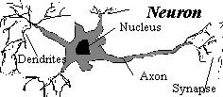
A Brief History of AI
1943
1950
1951
1956
1960
1963
1965
1968
1972
1975
1980
1981
1985
1986
1990
Neurons and the beginning of AI
1943 - McCulloch & Pitts proposed a model of artificial neurons
foundation: basic physiology of the brain
each neuron either 'on' or 'off'
Any computable function was shown to be computable by some network of connected neurons
Suggested that suitably defined networks could learn
1949 - Hebbs update rule
Notes:
The gestation of artificial intelligence (1943-1956)
The first work that is now generally recognized as AI was done by Warren McCulloch and Walter Pitts (1943). They drew on three sources: knowledge of the basic physiology and function of neurons in the brain; the formal analysis of propositional logic due to Russell and Whitehead; and Turing's theory of computation. They proposed a model of artificial neurons in which each neuron is characterized as being "on" or "off," with a switch to "on" occurring in response to stimulation by a sufficient number of neighboring neurons. The state of a neuron was conceived of as "factually equivalent to a proposition which proposed its adequate stimulus."
They showed, for example, that any computable function could be computed by some network of connected neurons, and that all the logical connectives could be implemented by simple net structures. McCulloch and Pitts also suggested that suitably defined networks could learn.
Donald Hebb (1949) demonstrated a simple updating rule for modifying the connection strengths between neurons, such that learning could take place.
The work of McCulloch and Pitts was arguably the forerunner of both the logicist tradition in AI and the connectionist tradition.

Slide 18
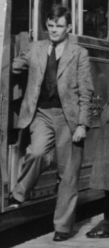
A Brief History of AI
1943
1950
1951
1956
1960
1963
1965
1968
1972
1975
1980
1981
1985
1986
1990
Alan Turing and the Turing Test
1950 - Alan Turing’s paper, Computing Machinery and Intelligence, described what is now called “The Turing Test”. http://www.abelard.org/turpap/turpap.htm
The first big milestone in Artificial Intelligence
Turing predicted that in about fifty years "an average interrogator will not have more than a 70 percent chance of making the right identification after five minutes of questioning”
Notes:
Acting humanly: The Turing Test approach
The Turing Test, proposed by Alan Turing (1950), was designed to provide a satisfactory operational definition of intelligence. Turing defined intelligent behavior as the ability to achieve human-level performance in all cognitive tasks, sufficient to fool an interrogator. Roughly speaking, the test he proposed is that the computer should be interrogated by a human via a teletype, and passes the test if the interrogator cannot tell if there is a computer or a human at the other end.
The computer would need to possess the following capabilities:
A natural language processing to enable it to communicate successfully in English (or some other human language);
B knowledge representation to store information provided before or during the interrogation;
C automated reasoning to use the stored information to answer questions and to draw new conclusions;
D machine learning to adapt to new circumstances and to detect and extrapolate patterns.
Turing's test deliberately avoided direct physical interaction between the interrogator and the computer, because physical simulation of a person is unnecessary for intelligence.

Slide 19
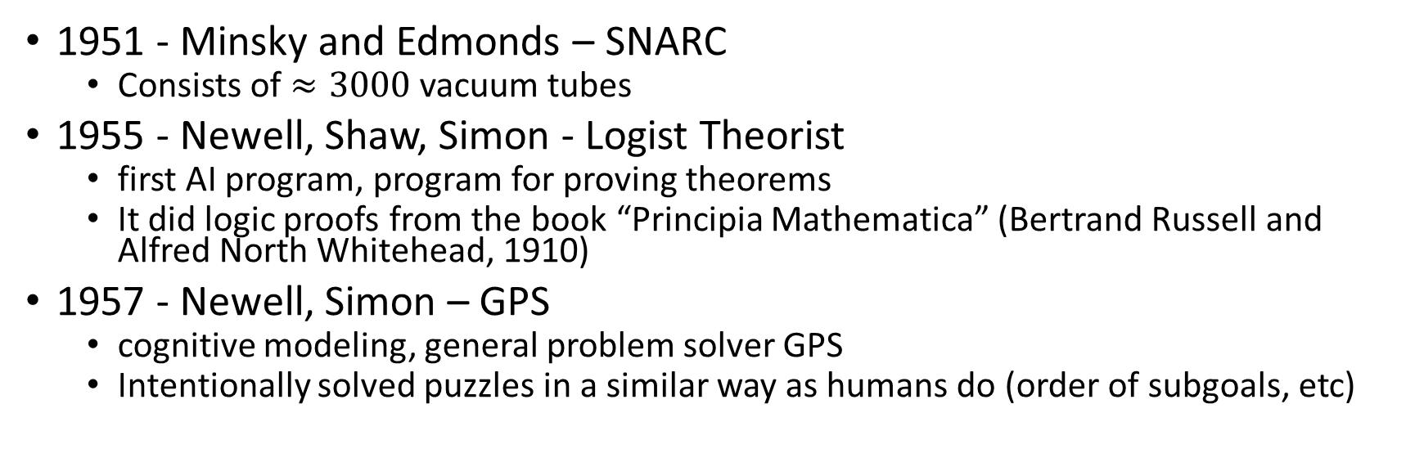
A Brief History of AI
1943
1950
1951
1956
1960
1963
1965
1968
1972
1975
1980
1981
1985
1986
1990
First attempts to develop Artificial Neural Nets
1951 - Minsky and Edmonds – SNARC
Consists of $≈3000$ vacuum tubes
1955 - Newell, Shaw, Simon - Logist Theorist
first AI program, program for proving theorems
It did logic proofs from the book “Principia Mathematica” (Bertrand Russell and Alfred North Whitehead, 1910)
1957 - Newell, Simon – GPS
cognitive modeling, general problem solver GPS
Intentionally solved puzzles in a similar way as humans do (order of subgoals, etc)
Notes:
Marvin Minsky and Dean Edmonds, built the first neural network computer in 1951. The SNARC, as it was called, used 3000 vacuum tubes and a surplus automatic pilot mechanism from a B-24bomber to simulate a network of 40 neurons.
Alien Newell and Herbert Simon started first developing an AI program based on neural nets. Although the others had ideas and in some cases programs for particular applications such as checkers, Newell and Simon already had a reasoning program, the Logic Theorist (LT), about which Simon claimed, "We have invented a computer program capable of thinking non numerically, and thereby solved the venerable mind-body problem.“ The program was able to prove most of the theorems in Chapter 2 of Russell and Whitehead's Principia Mathematica. Russell was reportedly delighted when Simon showed him that the program had come up with a proof for one theorem that was shorter than the one in Principia. The editors of the Journal of Symbolic Logic were less impressed; they rejected a paper coauthored
by Newell, Simon, and Logic Theorist.
Newell and Simon's early success was followed up with the General Problem Solver,
or GPS. Unlike Logic Theorist, this program was designed from the start to imitate human problem-solving protocols. Within the limited class of puzzles it could handle, it turned out that the order in which the program considered subgoals and possible actions was similar to the way humans approached the same problems. Thus, GPS was probably the first program to embody the "thinking humanly" approach. The combination of AI and cognitive science has continued at CMU up to the present day.

Slide 20
A Brief History of AI
1943
1950
1951
1956
1960
1963
1965
1968
1972
1975
1980
1981
1985
1986
1990
John McCarthy and the Dartmouth Conference
1956 – Dartmouth Workshop, initiated by John McCarthy to help bring together U.S. researchers interested in automata theory, neural nets, and the study of intelligence
John McCarthy used the term “Artificial Intelligence” for the first time as the topic for the conference
Proposal:
To prove that every aspect of learning or any other feature of intelligence can be so precisely described that a machine can be made to simulate it.
Notes:
McCarthy convinced Minsky, Claude Shannon, and Nathaniel Rochester to help him bring together U.S. researchers interested in automata theory, neural nets, and the study of intelligence.
They organized a two-month workshop at Dartmouth in the summer of 1956. All together there were ten attendees, including Trenchard More from Princeton, Arthur Samuel from IBM, and Ray Solomonoff and Oliver Selfridge from MIT.
The Dartmouth workshop did not lead to any new breakthroughs, but it did introduce all the major figures to each other. For the next 20 years, the field would be dominated by these people and their students and colleagues at MIT, CMU, Stanford, and IBM. Perhaps the most lasting thing to come out of the workshop was an agreement to adopt McCarthy's new name for the field: artificial intelligence.

Slide 21
A Brief History of AI
1943
1950
1951
1956
1960
1963
1965
1968
1972
1975
1980
1981
1985
1986
1990
Theoretical AI programming
1958 - McCarthy published a paper entitled “Programs with Common Sense”
Description of the Advice Taker, a hypothetical program that can be seen as the first complete AI system
1960 –Minsky published the paper “Steps Toward Artificial
Intelligence”
Notes:
In 1958, McCarthy published a paper entitled Programs with Common
Sense, in which he described the Advice Taker, a hypothetical program that can be seen as the first complete AI system. Like the Logic Theorist and Geometry Theorem Prover, McCarthy's program was designed to use knowledge to search for solutions to problems. But unlike the others, it was to embody general knowledge of the world. For example, he showed how some simple axioms would enable the program to generate a plan to drive to the airport to catch a plane. The program was also designed so that it could accept new axioms in the normal course of operation,
thereby allowing it to achieve competence in new areas without being reprogrammed. The Advice Taker thus embodied the central principles of knowledge representation and reasoning: that it is useful to have a formal, explicit representation of the world and the way an agent's actions affect the world, and to be able to manipulate these representations with deductive processes.

Slide 22

A Brief History of AI
1943
1950
1951
1956
1960
1963
1965
1968
1972
1975
1980
1981
1985
1986
1990
DoD‘s Advanced Research Project (DARPA)
In 1963 MIT received a 2.2 million dollar grant from the United States government to be used in researching Machine-Aided Cognition (artificial intelligence).
Served to increase the pace of development in AI research

Slide 23
A Brief History of AI
1943
1950
1951
1956
1960
1963
1965
1968
1972
1975
1980
1981
1985
1986
1990
Early expert systems
1965 - ELIZA by Weizenbaum - system engage in serious conversation
(example rule: if sentence contains “mother”, then say: “tell me more about your family”)
contained little or no knowledge of their subject matter, and succeeded by means of simple syntactic manipulations.
1969 – DENDRAL by Buchanan and Feigenbaum
Solve the problem of inferring molecular structures
196x – MYCIN by Feigenbaum, Buchanan and Shortlitte
450 rules; knowledge from experts; no domain theory
Topic: Blood infections
1968 SHRDLU by Winograd
Understanding of natural language
Notes:
Early programs often contained little or no knowledge of their subject matter.
Weizenbaum's ELIZA program (1965), which could apparently engage in serious conversation on any topic, actually just borrowed and manipulated the sentences typed into it by a human.
The DENDRAL program (Buchanan et a/., 1969) was an early example of using suitable knowledge of the domain. It was developed at Stanford, where Ed Feigenbaum (a former student of Herbert Simon), Bruce Buchanan (a philosopher turned computer scientist), and Joshua Lederberg (a Nobel laureate geneticist) teamed up to solve the problem of inferring molecular structure from the information
provided by a mass spectrometer. The significance of DENDRAL was that it was arguably the first successful knowledge-intensive system: its expertise derived from large numbers of special-purpose rules. Later systems also incorporated the main theme of McCarthy's Advice Taker approach— the clean separation of the
knowledge (in the form of rules) and the reasoning component.
Feigenbaum, Buchanan, and Dr. Edward Shortliffe developed MYCIN to
diagnose blood infections. With about 450 rules, MYCIN was able to perform as well as some experts, and considerably better than junior doctors. It also contained two major differences from DENDRAL. First, unlike the DENDRAL rules, no general theoretical model existed from which the MYCIN rules could be deduced. They had to be acquired from extensive interviewing of experts, who in turn acquired them from direct experience of cases. Second, the rules had to reflect the uncertainty associated with medical knowledge. MYCIN incorporated a calculus of uncertainty
called certainty factors (see Chapter 14), which seemed (at the time) to fit well with how doctors assessed the impact of evidence on the diagnosis.
The importance of domain knowledge was also apparent in the area of understanding
natural language. Although Winograd's SHRDLU system for understanding natural language had engendered a good deal of excitement, its dependence on syntactic analysis caused some of the same problems as occurred in the early machine translation work. It was able to overcome ambiguity and understand pronoun references, but this was mainly because it was designed specifically for one area—the blocks world.

Slide 24
A Brief History of AI
1943
1950
1951
1956
1960
1963
1965
1968
1972
1975
1980
1981
1985
1986
1990
Prolog
1970 – Alain Colmerauer developed Prolog
general-purpose logic programming language associated with artificial intelligence and computational linguistics.
Prolog programs describe relations, defined by means of clauses. Pure Prolog is restricted to Horn clauses.
Facts and rules
Recursion
Search strategy: SLD resolution (Selective Linear Definite clause resolution) is the basic inference rule
Notes:
Prolog is a general-purpose logic programming language associated with artificial intelligence and computational linguistics.^{[1][2][3]}
Prolog has its roots in first-order logic, a formal logic, and unlike many other programming languages, Prolog is declarative: the program logic is expressed in terms of relations, represented as facts and rules. A computation is initiated by running a query over these relations.^{[4]}
The language was first conceived by a group around Alain Colmerauer in Marseille, France, in the early 1970s and the first Prolog system was developed in 1972 by Colmerauer with Philippe Roussel.^{[5][6]}
Prolog was one of the first logic programming languages,^{[7]} and remains the most popular among such languages today, with several free and commercial implementations available. The language has been used for theorem proving,^{[8]} expert systems,^{[9]} as well as its original intended field of use, natural language processing.^{[10][11]} Modern Prolog environments support creating graphical user interfaces, as well as administrative and networked applications.
Prolog is well-suited for specific tasks that benefit from rule-based logical queries such as searching databases, voice control systems, and filling templates.

Slide 25
A Brief History of AI
1943
1950
1951
1956
1960
1963
1965
1968
1972
1975
1980
1981
1985
1986
1990
AI becomes an industry
XCON(R1) first real commercial expert system on DEC VAX
1988 – sales exceeded $2 billion
Notes:
The first successful commercial expert system, Rl, began operation at Digital Equipment Corporation (McDermott, 1982). The program helped configure orders for new computer systems,and by 1986, it was saving the company an estimated $40 million a year. By 1988, DEC's AI group had 40 deployed expert systems, with more on the way. Du Pont had 100 in use and 500 in development, saving an estimated $10 million a year. Nearly every major U.S. corporation had its own AI group and was either using or investigating expert system technology.
Overall, the industry went from a few million in sales in 1980 to $2 billion in 1988.

Slide 26
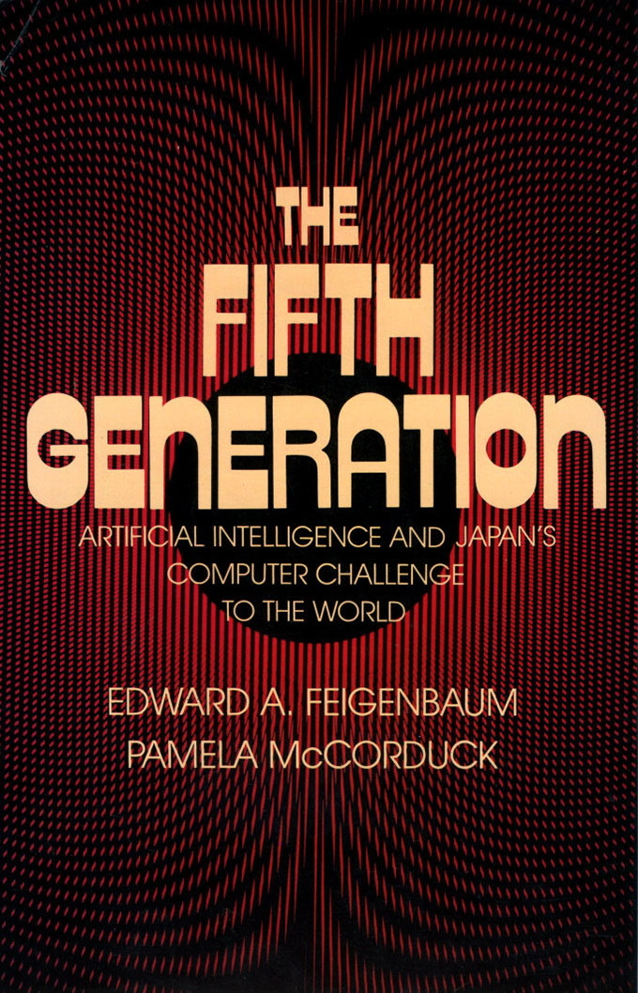
A Brief History of AI
1943
1950
1951
1956
1960
1963
1965
1968
1972
1975
1980
1981
1985
1986
1990
Japanese Fifth generation project
1981 – Japanese project to create an entirely new computer technology
10-year plan to build intelligent computers
spending $400 million by the Japanese Government
The goal was to break down the western technological supremacy and bring japan economy to a technological leadership
The results were frustrating
Notes:
In 1981, the Japanese announced the "Fifth Generation" project, a 10-year plan to build intelligent computers running Prolog in much the same way that ordinary computers run machine code. The idea was that with the ability to make millions of inferences per second, computers would be able to take advantage of vast stores of rules. The project proposed to achieve full-scale natural language understanding, among other ambitious goals.
The Japanese Fifth Generation Project in computer technology was an attempt to leapfrog Western computer expertise and create an entirely new computer technology. The Japanese Fifth Generation project was a collaborative effort of the Japanese computer industry coordinated by the Japanese Government that intended not only to update the hardware technology of computers but alleviate the problems of programming by creating AI operating systems that would ferret out what the user wanted and then do it. The Project chose to use PROLOG as the computer language for the AI programming.
"Ten years ago we faced criticism of being too reckless," said Kazuhiro Fuchi, Fifth Generation's head. "Now we see criticism from inside and outside the country because we have failed to achieve such grand goals."
The story itself was as follows:
Tokyo June 4.--A bold 10-year effort by Japan to seize the lead in computer technology is fizzling to a close having failed to meet many of its ambitious goals or to produce technology that Japan's computer industry wanted. After spending $400 million on its widely heralded Fifth Generation computer project, the Japanese Government said this week that it was willing to give away the software developed by the project to anyone who wanted it, even foreigners.
The problem for Japan is that the computer industry shifted so rapidly that the technological path the Fifth Generation took-- which seemed a wise choice in 1982-- turned out to be at odds with the computer industry's direction by 1992. In a sense, Japan's ability to stay the course in pursuit of a long-term payoff-- usually considered one of the country's strongest assets-- turned into a liability. A similar challenge for Japan may now be arising in high-definition television. Japan's HDTV system, which has been in development for two decades, is now coming to market just as some engineers believe that major shift to digital television technology will make the Japanese analog approach obsolete. Yet interest in joining government-industry projects continues in Japan. Another computer technology program, called the Real World Computing project, is getting underway. Executives here said that such programs could lead to valuable results even if no useful products emerge from the pipeline. A benefit of the Fifth Generation project, for instance, is that it trained hundreds , perhaps thousands, of engineers in advanced computer science.

Slide 27
A Brief History of AI
1943
1950
1951
1956
1960
1963
1965
1968
1972
1975
1980
1981
1985
1986
1990
Return of Artificial Neural Nets
Mid 80‘s- reinvention of back-propagation learning algorithm
Startup companies
Mid-1980s, different research groups reinvented backpropagation (originally from 1969)
Disillusionment on expert systems
Fear of AI winter
Notes:
The real impetus for the return of ANN came in the mid-1980s when at least four different groups reinvented the back-propagation learning algorithm first found
in 1969 by Bryson and Ho. The algorithm was applied to many learning problems in computer science and psychology, and the widespread dissemination of the results in the collection Parallel Distributed Processing (Rumelhart and McClelland, 1986) caused great excitement.
At about the same time, some disillusionment was occurring concerning the applicability of the expert system technology derived from MYCiN-type systems. Many corporations and research groups found that building a successful expert system involved much more than simply buying a reasoning system and filling it with rules.
Some predicted an "AI Winter" in which AI funding would be squeezed severely. It was perhaps this fear, and the historical factors on the neural network side, that led to a period in which neural networks and traditional AI were seen as rival fields, rather than as mutually supporting approaches to the same problem

Slide 28
A Brief History of AI
1943
1950
1951
1956
1960
1963
1965
1968
1972
1975
1980
1981
1985
1986
1990
Recent events
Fuzzy logic and neural networks used in controllers, especially in Japan and Europe
Recent developments and areas of great interest include:
Bayesian reasoning and Bayes nets
Ontologies, knowledge reuse, and knowledge acquisition
Mixed-initiative systems that combine the best of human and computer reasoning
Multi-agent systems, Internet economies, intelligent agents
Autonomous systems for space exploration, search and rescue, hazardous environments
überarbeiten
Notes:
There is a question of what age we're in right now. We could call it the age of emancipation. Emancipation of limits we defined to explain if it is AI or not, of limits of computer power and capacities, limits of knowledge and domains. Emancipation by applying AI to a huge number of different tasks and domains.
And emancipation of pure theories, of theories that reasoning can bring us intelligence, that we can deal with perception, with deduction, with acting separadly.
To form a paradigm it was important to define the building blocks, investigate them separately, model them, test them, but now we combine the blocks and achieve more complex applications and smart agents

Slide 29
Neural Networks Resurrection
Hopfield net (John Hopfield, 1982)
It can learn a couple of pictures (patterns).
Self-Organizing Map (SOM) (Teuvo Kohonen, 1982)
It can do unsupervised learning.
Backpropagation (Arthur Bryson and Yu-Chi Ho, 1969)
algorithm for training of a multilayer neural network
It needs network’s neurons not to have a sharp threshold.
Because it was not noticed, it was then rediscovered several times in the 70’s and the 80’s of the 20th century and popularized in 1986.
NETtalk (Terry Sejnowski and Charles Rosenberg, 1986)
Multi-layer neural network, that learned English pronunciation and could generalize.
It used the backpropagation algorithm.

Slide 30
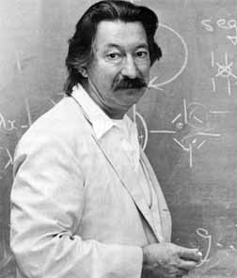
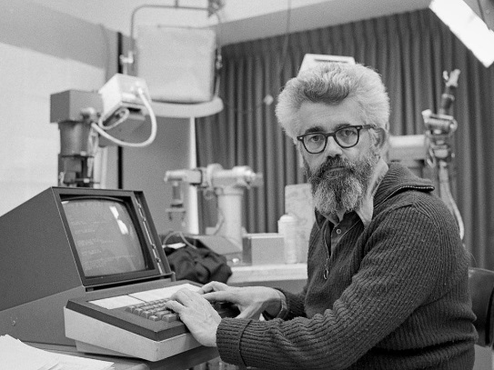
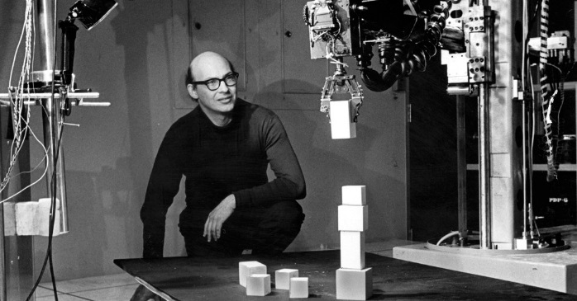
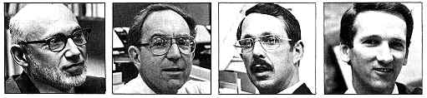
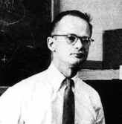
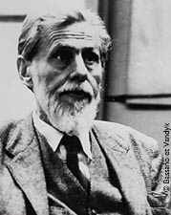
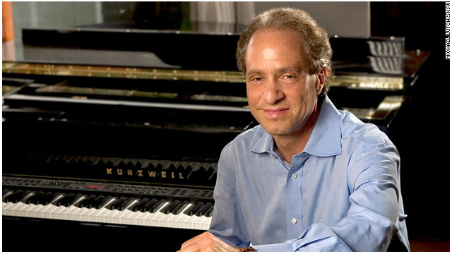
AI history – the people behind
John McCarthy
Marvin Minsky
Weizenbaum
Feigenbaum, Lederberg, Buchanan, Shortliffe
Pitts
Alan Turing
Culloch
Ray Kurzweil

Slide 31
The Most Important AI Laboratories
MIT (Massachusetts Institute of Technology)
1959 - John McCarthy and Marvin Minsky founded Artificial Intelligence Laboratory.
SRI (Stanford Research Institute)
1963 - John McCarthy founded AI Laboratory.
CMU (Carnegie Mellon University)
1980 - Raj Reddy founded The Robotics Institute.
IBM
Watson (analysis of texts by means of commercial cloud applications)
Amazon
Amazon Machine Learning (business data analysis)
Google
Quantum AI Lab – application of quantum computing on artificial intelligence and machine learning
DeepMind – British acquisition that has developed algorithms for playing Go and Atari video games
OpenAI
nonprofit research company of Elon Musk

Slide 32
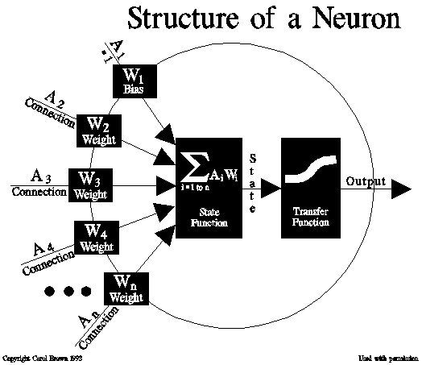
Neural Networks
Switch to 'on' (response) if sufficient number of neighbors are 'on' (stimulus)
Training - reading sample data and iteratively adjusting the network's weights to produce optimum predictions
A BOTTOM-UP architecture

Slide 33
Neural Networks
Results:
Any computable function was shown to be computable by some network of connected neurons
Suggested that suitably defined networks could learn
Neural Network Program -Simulates Predator & Prey Behaviors

Slide 34
Neural Networks - Advantages
Much faster than an ordinary processor
Have multiple processes reaching conclusions simultaneously and evaluating the best response

Slide 35
Neural Networks – Problems
Expensive to construct
The Von Neuman computer architecture is standard
1968 - Marvin Minsky & Seymour Papert demonstrate limits of simple neural nets (Perceptions)

Slide 36
Present
Robotic toys, space probes
Robotics in machinery
Home appliances (washers, vacuum cleaners)
Data Mining, fraud detection, spam filtering
Searching on the Internet (web agents)
Modeling of interactive processes (agents)
E-business – e-shops personalization
Intelligent tutoring systems and SW interfaces
Role-playing games, chess programs
Speech and video recognition
Machine translation

Slide 37
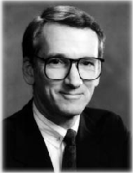
Mycin
Expert system developed at Stanford in the 1970s
One of the first experts systems worldwide and an important milestone in history
deals with diagnose and recommend treatment for certain blood infections
Mycin is an early backward chaining expert system
Developed by Edward Shortliffe under the direction of Bruce G. Buchanan, Stanley N. Cohen and others.
Mycin uses a fairly simple inference engine, and a knowledge base of ~600 rules.
Dr. Shortliffe
Notes:
MYCIN: A Quick Case Study
Mycin was one of the earliest expert systems, and its design has strongly influenced the design of commercial expert systems and expert system shells.
Mycin was an expert system developed at Stanford in the 1970s. Its job was to diagnose and recommend treatment for certain blood infections. To do the diagnosis ``properly'' involves growing cultures of the infecting organism. Unfortunately this takes around 48 hours, and if doctors waited until this was complete their patient might be dead! So, doctors have to come up with quick guesses about likely problems from the available data, and use these guesses to provide a ``covering'' treatment where drugs are given which should deal with any possible problem.
Mycin was developed partly in order to explore how human experts make these rough (but important) guesses based on partial information. However, the problem is also a potentially important one in practical terms - there are lots of junior or non-specialised doctors who sometimes have to make such a rough diagnosis, and if there is an expert tool available to help them then this might allow more effective treatment to be given. In fact, Mycin was never actually used in practice. This wasn't because of any weakness in its performance - in tests it outperformed members of the Stanford medical school. It was as much because of ethical and legal issues related to the use of computers in medicine - if it gives the wrong diagnosis, who do you sue?
Anyway Mycin represented its knowledge as a set of IF-THEN rules with certainty factors. The following is an English version of one of Mycin's rules:
IF the infection is pimary-bacteremia AND the site of the culture is one of the sterile sites AND the suspected portal of entry is the gastrointestinal tract THEN there is suggestive evidence (0.7) that infection is bacteroid. The 0.7 is roughly the certainty that the conclusion will be true given the evidence. If the evidence is uncertain the certainties of the bits of evidence will be combined with the certainty of the rule to give the certainty of the conclusion.
Mycin was written in Lisp, and its rules are formally represented as Lisp expressions. The action part of the rule could just be a conclusion about the problem being solved, or it could be an arbitary lisp expression. This allowed great flexibility, but removed some of the modularity and clarity of rule-based systems, so using the facility had to be used with care.
Anyway, Mycin is a (primarily) goal-directed system, using the basic backward chaining reasoning strategy that we described above. However, Mycin used various heuristics to control the search for a solution (or proof of some hypothesis). These were needed both to make the reasoning efficient and to prevent the user being asked too many unnecessary questions.
One strategy is to first ask the user a number of more or less preset questions that are always required and which allow the system to rule out totally unlikely diagnoses. Once these questions have been asked the system can then focus on particular, more specific possible blood disorders, and go into full backward chaining mode to try and prove each one. This rules out alot of unecessary search, and also follows the pattern of human patient-doctor interviews.
The other strategies relate to the way in which rules are invoked. The first one is simple: given a possible rule to use, Mycin first checks all the premises of the rule to see if any are known to be false. If so there's not much point using the rule. The other strategies relate more to the certainty factors. Mycin will first look at rules that have more certain conclusions, and will abandon a search once the certainties involved get below 0.2.
A dialogue with Mycin is somewhat like the mini dialogue we gave in section 5.3, but of course longer and somewhat more complex. There are three main stages to the dialogue. In the first stage, initial data about the case is gathered so the system can come up with a very broad diagnosis. In the second more directed questions are asked to test specific hypotheses. At the end of this section a diagnosis is proposed. In the third section questions are asked to determine an appropriate treatment, given the diagnosis and facts about the patient. This obviously concludes with a treatment recommendation. At any stage the user can ask why a question was asked or how a conclusion was reached, and when treatment is recommended the user can ask for alternative treatments if the first is not viewed as satisfactory.
Mycin, though pioneering much expert system research, also had a number of problems which were remedied in later, more sophisticated architectures. One of these was that the rules often mixed domain knowledge, problem solving knowledge and ``screening conditions'' (conditions to avoid asking the user silly or awkward questions - e.g., checking patient is not child before asking about alcoholism). A later version called NEOMYCIN attemped to deal with these by having an explicit disease taxonomy (represented as a frame system) to represent facts about different kinds of diseases. The basic problem solving strategy was to go down the disease tree, from general classes of diseases to very specific ones, gathering information to differentiate between two disease subclasses (ie, if disease1 has subtypes disease2 and disease3, and you know that the patient has the disease1, and subtype disease2 has symptom1 but not disease3, then ask about symptom1.)
There were many other developments from the MYCIN project. For example, EMYCIN was really the first expert shell developed from Mycin. A new expert system called PUFF was developed using EMYCIN in the new domain of heart disorders. And systom called NEOMYCIN was developed for training doctors, which would take them through various example cases, checking their conclusions and explaining where they went wrong.
We should make it clear at this point that not all expert systems are Mycin-like. Many use different approaches to both problem solving and knowledge representation. A full course on expert systems would consider the different approaches used, and when each is appropriate. Come to AI4 for more details!

Slide 38
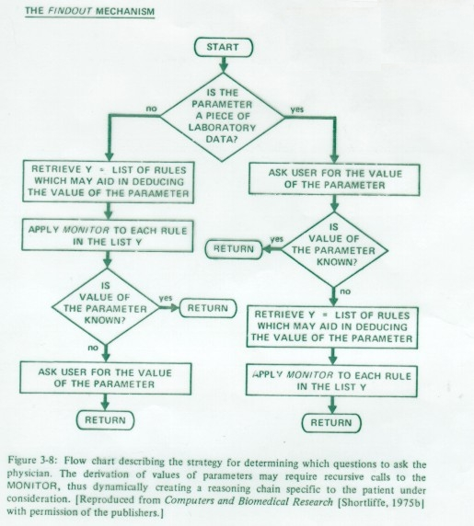
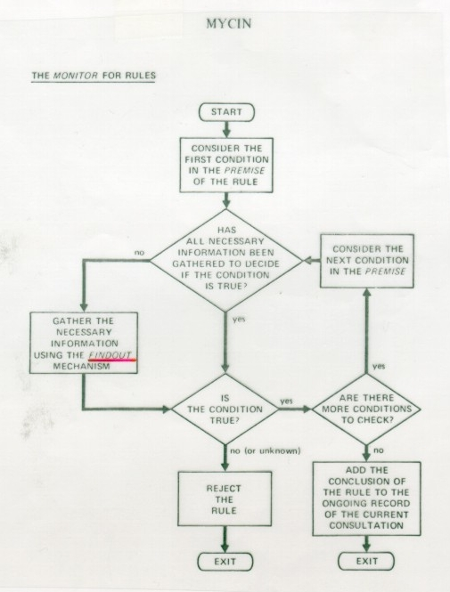

Slide 39
Mycin
It would query the physician running the program via a long series of simple yes/no or textual questions. At the end, it provided a list of possible culprit bacteria ranked from
In MYCIN it was possible that two or more rules might draw conclusions about a parameter with different weights of evidence. For example one rule may conclude that the organism in question is E. Coli with a certainty of 0.8 whilst another concludes that it is E. Coli with a certainty of 0.5 or even -0.8. In the event the certainty is less than zero the evidence is actually against the hypothesis. In order to calculate the certainty factor MYCIN combined these weights using the formula below to yield a single certainty factor:

Slide 40
Mycin
MYCIN -- A typical consultation
1. Patient’s name: (first - last)
** FRED BRAUN (Questions 1-3 requestbackground patient data).
2. Sex:
** M
3. Age:
** 55
4. Are there any cultures for Fred Braun which may be related to the present illness, and from which organisms have been grown successfully in the microbiology laboratory?
** Y
- - - CULTURE - 1 - - -
5. From what site was the specimen for CULTURE - 1 taken?
** BLOD
= BLOOD (System corrects typing error).
6. Please give the date and time when CULTURE-1 was obtained.
(mo/da/yr time)
** JUN 20, 1977
The first organism isolated from the blood culture of 20-JUN-77 (CULTURE-1) will be referred to as:
- - - ORGANISM - 1 - - -
7. Enter the laboratory - reported identity of ORGANISM-1:
** UNKNOWN (Typically identity is not known yet).
8. The strain (gram or Ziehl-Neelsen acid-fast) of ORGANISM-1:
** NEG (Preliminary lab results give some clues).
9. Is ORGANISM - 1 rod or coccus (etc.):
** ROD
10. What is the form of the individual organisms (e.g. lancet-shaped for cocci, fusiform for rods, etc)?
** FUSIFORM
(... more questions follow in order to gather sufficient information to infer the identity and significance of the infecting organisms ...)
23. What is the suspected portal of entry of the gramneg rod from the blood culture of 20-JUN-77 (ORGANISM-1) into this sterile site?
** GI (6) (User indicates the uncertainty of his response).
24. Is Fred Braun a burn patient?
** N
25. Is Fred Braun a compromised host
(e.g. alcoholic, sickle-cell-disease, immunosuppressed)?
** N
26. Is Fred Braun febrile?
** Y
( ... after about 50-60 questions, MYCIN prints the diagnostic hypotheses on which therapy will be based ...)
My therapy recommendations will be designed to treat for organisms that are either very likely, or, although less likely, would have a significant effect on therapy selection if they were present. It is important to cover for the following probable infection(s) and associated organism(s):
INFECTION-1 is BACTEREMIA
<ITEM-1> E.COLI [ORGANISM-1]
<ITEM-2> KLEBSIELLA [ORGANISM-1]
<ITEM-3> ENTEROBACTER [ORGANISM-1]
<ITEM-4> KLEBSIELLA-PNEUMONIAE [ORGANISM-1]
** WHAT DOES GU MANIPULATION TELL YOU ABOUT THE IDENTITY OF AN ORGANISM?
The rules listed below use:
whether the patient has had a genito-urinary manipulative procedure to conclude about: the identity of the organism
156, 163, 190
Which do you wish to see?
** 156
RULE 156
IF: 1. The site of the culture blood, and
2. The gram stain of the organism is gramneg, and
3. The morphology of the organism is rod, and
4. The portal of entry of the organism is urine, and
5. The patient has not had a genito-urinary manipulative procedure, and
6. Cystitis is not a problem for which the patient has been treated
THEN: There is suggestive evidence (.6) that the identity of the organism is e.coli
** IS BLOOD A STERILE SITE?
Yes. Blood is one of those sites that is normally sterile.
** WHAT ARE THE NONSTERILE SITES?
Those sites that are normally nonsterile are: CERVIX, CUTANEOUS-ULCER, LOCHIA, NOSE, SKIN, STOOL, THROAT, URETHRA, VAGINA.
** IS BACTEROIDES AEROBIC?
No, the aerobicity of bacteroides is anaerobic.

Slide 41
Heuristics
Problem-solving method that is usually successful, but can fail i some situations
Unclearly defined problems with missing or ambiguous data
Medical diagnosis
Vision, speech recognition
Helps to decide among infinite number of possible interpretations.
A problem may have an exact solution, but the computational cost of finding it may be prohibitive.
Chess, tic-tac-toe, 15 or 8-puzzle, scheduling, path-finding…
Heuristic evaluation function
Evaluates each stage of solution.
Number of conflicts in a number of possible schedules
Helps to decide about the next step leading to the goal.
Selecting the schedule with minimum number of conflicts for the next small changes attempting to find some correct schedule

